Slide 1

CRISPR: From Discovery to Clinic
A concise tour from bacterial immunity to first-in-class human therapies—spanning foundational science, sophisticated delivery platforms, rigorous safety frameworks, ethical considerations, and emerging market dynamics. In just over a decade, CRISPR has evolved from a curious bacterial defense mechanism into a programmable toolkit reshaping the future of medicine, agriculture, and biotechnology.
This presentation distills the arc of CRISPR innovation: the pioneering researchers who unlocked its potential, the elegant molecular mechanics that power precise genome editing, the clinical milestones that brought laboratory concepts into patients, and the translational challenges that still define the pathway to widespread therapeutic deployment.

Slide 2

Programmable Medicine
Guided by a short RNA molecule, CRISPR tools cut, nick, or rewrite DNA and RNA sequences with exquisite specificity—transforming genetic sequence into a therapeutic address. This programmability represents a fundamental shift: rather than small molecules that modulate protein function or antibodies that block cell-surface receptors, CRISPR therapies rewrite the instruction manual itself.
The elegance lies in simplicity. A 20-nucleotide guide RNA directs the Cas nuclease to any matching genomic locus, creating a molecular GPS for precision intervention. By changing the guide sequence, researchers can target virtually any gene—opening therapeutic windows for thousands of genetic diseases previously deemed undruggable.

Slide 3
Presentation Roadmap
01
02
03
Discovery & Key Figures
How CRISPR Works
Breakthroughs Timeline
The scientists who pioneered programmable genome editing
Molecular mechanism diagrams and editing modalities
Critical milestones from 2012 to first regulatory approvals
04
05
06
Delivery Modalities
Therapeutic Pipeline Landscape
Market Outlook
AAV, LNP, electroporation, and emerging platforms
Programs by disease area and clinical stage
Revenue projections and segment growth trajectories
07
08
09
Clinical Risks, Ethics & Regulation
Case Studies
What's Next: Future Outlook
Real-world therapeutic programs and clinical data
Emerging technologies and access strategies
Safety frameworks and governance principles

Slide 4


Key Figures
Jennifer Doudna, PhD
Emmanuelle Charpentier, PhD
UC Berkeley biochemist who co-discovered programmable CRISPR-Cas9 genome editing in 2012, fundamentally transforming molecular biology. Beyond the lab bench, Doudna has been a leading voice in governance and ethical discourse surrounding genome editing technologies, convening stakeholders to establish responsible innovation frameworks.
Microbiologist whose identification of tracrRNA was pivotal to understanding and engineering the CRISPR-Cas9 system. Her work deciphering the dual-RNA structure enabled the simplified single-guide RNA design that made CRISPR accessible to laboratories worldwide.
2020 Nobel Prize in Chemistry (shared with Emmanuelle Charpentier) recognized the transformative impact of their work.
Founding and scientific leadership at the Max Planck Unit for the Science of Pathogens continues to advance precision microbiology and therapeutic development.
"This technology gives us a way to rewrite the code of life. With that power comes profound responsibility."
"CRISPR is a simple concept with transformative implications when directed with precision and care."

Slide 5

How CRISPR Works
Core Mechanism: Recognition, Cleavage, and Repair
Target Selection
Cutting
Cas9 scans DNA for a PAM sequence (e.g., NGG). The 20-nucleotide guide RNA (gRNA) base-pairs with the complementary protospacer sequence immediately upstream of the PAM, forming an RNA-DNA heteroduplex that positions the nuclease domains.
Cas9's HNH domain cleaves the target strand (complementary to gRNA), while the RuvC domain cleaves the non-target strand. This coordinated action creates a blunt-ended double-strand break (DSB) precisely three base pairs upstream of the PAM.
Repair Pathway A: NHEJ
Repair Pathway B: HDR
Non-homologous end joining is the predominant repair mechanism in most cells. This error-prone pathway ligates broken ends directly, often introducing small insertions or deletions (indels) that cause frameshift mutations and gene knockout.
When a donor DNA template with homology arms is supplied, homology-directed repair can copy precise sequences into the break site. This pathway enables gene correction, knock-ins, and targeted insertions—though it operates primarily in dividing cells and at lower efficiency than NHEJ.
Editor Variants: Beyond the Double-Strand Break
Base Editors (ABE/CBE)
Prime Editors
Architecture: Catalytically impaired Cas9 (nCas9 or dCas9) fused to a deaminase enzyme
Architecture: nCas9 fused to reverse transcriptase, programmed by a prime editing guide RNA (pegRNA)
Mechanism: Single-base conversions (A↔G via adenine deaminase; C↔T via cytosine deaminase) within a narrow editing window, without creating a double-strand break
Mechanism: The pegRNA encodes both the target site and the desired edit. Reverse transcriptase synthesizes the edited sequence directly onto the nicked strand, enabling small insertions, deletions, or all 12 possible base-to-base conversions
Advantage: Reduced indel formation and lower risk of chromosomal rearrangements; ideal for correcting point mutations
Advantage: Versatile "search-and-replace" editing with minimal by-products
Essential Glossary
gRNA (guide RNA): The programmable RNA molecule that directs the nuclease to a specific DNA sequence via Watson-Crick base pairing
PAM (Protospacer Adjacent Motif): A short DNA sequence required for Cas nuclease binding and cleavage; for SpCas9, the PAM is NGG (where N = any nucleotide)
RNP (Ribonucleoprotein): A complex of purified Cas protein pre-loaded with guide RNA, used for transient editing with rapid clearance

Slide 6
Breakthroughs Timeline
The path from bacterial curiosity to approved medicine unfolded with remarkable speed, driven by elegant science, bold translational bets, and rigorous clinical validation.
2012 — Programmable CRISPR-Cas9 Editing
1
Proof point: In vitro demonstration of RNA-guided DNA cleavage (Jinek et al., Science). This foundational study showed that tracrRNA and crRNA could be fused into a single-guide RNA, creating a simple two-component system (Cas9 + sgRNA) that could be programmed to cut any DNA sequence adjacent to a PAM.
2
2013 — Editing in Mammalian Cells
Proof point: Multiple labs simultaneously published CRISPR-Cas9 editing in human cells, demonstrating targeted gene disruption and homology-directed repair. This milestone opened therapeutic development, showing the system functions robustly in the complex chromatin environment of eukaryotic nuclei.
2016 — Base Editing Introduced
3
Proof point: David Liu's lab unveiled cytosine and adenine base editors (CBE, ABE), expanding the toolkit to enable single-nucleotide changes without double-strand breaks. This innovation dramatically reduced indel by-products and addressed ~60% of known pathogenic point mutations.
4
2019 — Prime Editing Unveiled
Proof point: Prime editing enabled versatile insertions, deletions, and all 12 base-to-base conversions without requiring donor DNA or double-strand breaks. Early demonstrations showed correction of disease mutations in primary human cells with minimal off-target effects.
2020 — Nobel Prize in Chemistry
5
Proof point: The Royal Swedish Academy of Sciences awarded Doudna and Charpentier the Nobel Prize for CRISPR-Cas9, recognizing the technology's "revolutionary impact" on life sciences and medicine. This acknowledgment came less than a decade after the initial publication—unprecedented speed for Nobel recognition.
6
2021 — First In Vivo CRISPR Infusion
Proof point: Intellia's NTLA-2001 program for ATTR amyloidosis demonstrated dose-dependent TTR protein reduction (up to ~90%) after a single intravenous dose of lipid nanoparticle-formulated Cas9 mRNA and guide RNA. This landmark study proved systemically delivered CRISPR could edit human hepatocytes in situ.
2022 — First In-Human Base Editing Data
7
Proof point: Verve Therapeutics reported clinical data from VERVE-101, an in vivo adenine base editor targeting PCSK9 for familial hypercholesterolemia. Early-phase results showed sustained LDL cholesterol lowering, validating base editing as a clinical modality.
8
2023–24 — First Regulatory Approvals
Proof point: Exagamglogene autotemcel (exa-cel/CASGEVY) received approvals in the UK, US, and EU for severe sickle cell disease and transfusion-dependent β-thalassemia. This ex vivo autologous HSPC therapy marks the first commercially available CRISPR medicine, with post-marketing commitments for long-term safety registries.

Slide 7

Delivery Modalities: Getting Editors to Cells
Delivery remains the critical bottleneck translating CRISPR's molecular precision into therapeutic impact. Each platform brings distinct trade-offs in tropism, duration, immunogenicity, and manufacturing complexity.
Adeno-Associated Virus (AAV)
Works best for: In vivo editing in tissues with suitable serotypes—retina (AAV2, AAV5), muscle (AAV9), CNS subtypes (AAV9, AAVrh10), liver (AAV8).
Pros: Strong tropism and transduction efficiency; single-dose potential with durable transgene expression; extensive clinical precedent from gene-replacement therapies.
Constraints: Capsid packaging limits (~4.7 kb) constrain large editor payloads; pre-existing neutralizing antibodies in 30–60% of adults hamper transduction and preclude re-dosing; potential for random vector integration at low frequency; high-dose hepatotoxicity observed in some programs.
Notables: EDIT-101 (AAV5) targets a deep intronic splice mutation in CEP290 for LCA10; Dual-AAV strategies or compact nucleases like SaCas9 mitigate payload constraints.
Lipid Nanoparticles (LNP)
Works best for: In vivo delivery to hepatocytes via ApoE-mediated uptake; extrahepatic tropism emerging through ligand conjugation and ionizable lipid engineering.
Pros: Transient mRNA expression reduces prolonged on-target and off-target exposure; scalable GMP manufacturing with modular chemistry; potential for repeat dosing in antibody-naive contexts; leverages validated COVID-19 vaccine platforms.
Constraints: Strong hepatocyte bias limits tropism without further engineering; infusion-related reactions (cytokine release) require premedication; dose ceiling and endosomal escape efficiency remain key optimization targets.
Notables: NTLA-2001 (Cas9 mRNA + gRNA LNP) for ATTR demonstrates >80% serum TTR reduction; VERVE-101 (ABE mRNA + gRNA LNP) targets hepatic PCSK9 for sustained LDL-C lowering.
Electroporation (Ex Vivo)
Works best for: Autologous and allogeneic cell therapies—hematopoietic stem/progenitor cells (HSPCs), T cells, NK cells, and iPSC-derived products.
Pros: Transient RNP delivery minimizes off-target window; high editing rates (often >80%) with multiplex capability; no viral DNA integration or capsid immunogenicity concerns.
Constraints: Complex manufacturing workflows (apheresis, cell culture, QC, cryopreservation); conditioning regimens for engraftment (e.g., myeloablation for HSPCs); logistical challenges in patient scheduling, product release testing, and cold-chain distribution.
Notables: Exa-cel/CASGEVY targets the BCL11A erythroid enhancer in autologous HSPCs for SCD/TDT; multiplex-edited allogeneic CAR-T programs knock out endogenous TCR, B2M, and immune checkpoints to create off-the-shelf products.
Non-Viral & Emerging Platforms
Works best for: Specialized tissues (ocular via subretinal injection); investigational systemic and extracellular targets.
Pros: Potential for targeted delivery via antibody or receptor-ligand conjugation; avoids pre-existing immunity to viral vectors; modular design space.
Constraints: Historically lower transfection efficiency compared to viral or electroporation methods; formulation stability, biodistribution, and endosomal escape remain active R&D challenges.
Notables: Virus-like particles (VLPs) encapsulate RNP cargo; polymeric carriers and hybrid ionizable lipid systems under preclinical investigation; hydrodynamic and microinjection techniques for specialized applications (e.g., direct ocular delivery).

Slide 8

Therapeutic Pipeline Landscape
CRISPR programs span discovery research through approved therapies, with the field rapidly maturing. The distribution reflects both biological tractability (ex vivo HSPCs, hepatocytes accessible via LNP) and unmet medical need in rare genetic diseases.
Hematology (Ex Vivo)
Cardio-Metabolic (In Vivo, Liver)
Ophthalmology (In Vivo, Ocular)
Indications: Sickle cell disease, β-thalassemia
Indications: ATTR amyloidosis, hypercholesterolemia (PCSK9 editing), lipoprotein(a) lowering
Indications: Leber congenital amaurosis 10 (LCA10), choroideremia
Representative programs: Exa-cel/CASGEVY (BCL11A enhancer knockout to induce fetal hemoglobin); BEAM-101 (base-edited HSPCs to correct HBB mutation)
Representative programs: EDIT-101 (AAV5-delivered CEP290 intronic splice correction via subretinal injection)
Representative programs: NTLA-2001 (TTR knockout); VERVE-101 (PCSK9 adenine base edit); emerging Lp(a) silencing programs
Oncology (Ex Vivo)
Rare Genetic Diseases
Indications: B-cell malignancies (ALL, DLBCL, MM); solid tumors (investigational)
Indications: Alpha-1 antitrypsin deficiency (AATD), Duchenne muscular dystrophy (DMD), emerging CNS and hearing-loss targets
Representative programs: Multiplex-edited allogeneic CAR-T and CAR-NK products with PD-1, TRAC, and B2M knockouts; armored CAR-T with cytokine or checkpoint inhibitor payloads
Representative programs: In vivo prime and base editors; targeted LNPs and next-generation AAV capsids for extrahepatic tropism
Clinical Stage Distribution (Approximate)
200+
~40
~10
3–5
Discovery/Preclinical
Phase 1
Phase 2
Phase 3
Target identification and proof-of-concept studies
First-in-human safety and dose escalation
Efficacy signals and optimal dosing
Pivotal trials for regulatory submissions
1
Approved
Exa-cel/CASGEVY (2023–24)
First Approved CRISPR Therapy
Exagamglogene autotemcel (exa-cel/CASGEVY)
Modality: Ex vivo CRISPR/Cas9 RNP editing of autologous HSPCs; BCL11A erythroid enhancer disruption induces fetal hemoglobin (HbF) to compensate for defective adult hemoglobin.
Indications: Severe sickle cell disease with recurrent vaso-occlusive crises; transfusion-dependent β-thalassemia
Status: Approved in UK (MHRA, 2023), US (FDA, 2023), EU (EMA, 2024) with post-marketing long-term follow-up registries

Slide 9
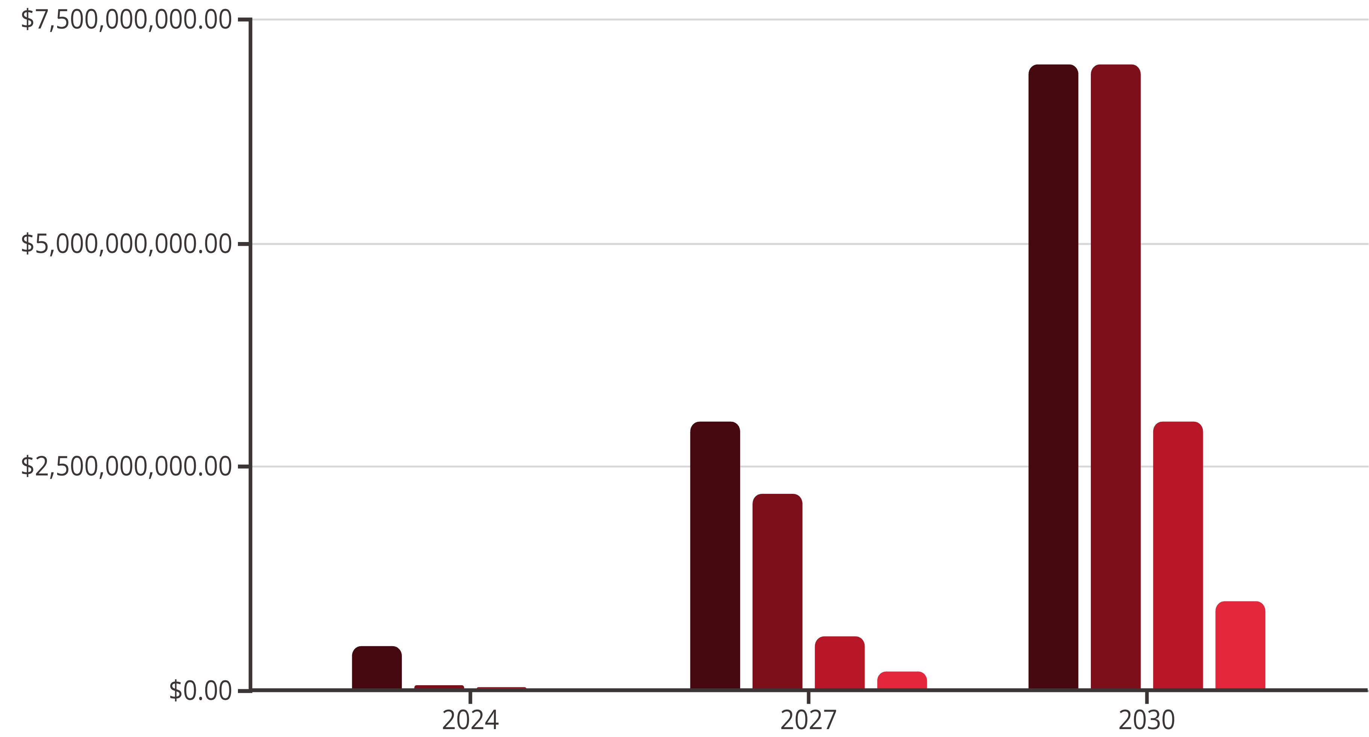
Market Outlook: CRISPR Therapeutics
Illustrative revenue projections reflect progressive approvals, manufacturing scale-up, and extrahepatic delivery breakthroughs. These scenarios are directional and intended for strategic planning—not investment advice.
Ex Vivo Cell Therapies
In Vivo Liver
In Vivo Extrahepatic
Ocular
Key Assumptions
Market Drivers
Progressive regulatory approvals in hematology (SCD, TDT, additional hemoglobinopathies) and liver-tropic indications (ATTR, FH, Lp(a)) through the decade
Expanding label indications and geographies for approved products
Manufacturing scale-up reduces cost of goods and broadens patient access, supported by automation, closed systems, and distributed manufacturing hubs
Entry of base and prime editing modalities with improved safety profiles
Allogeneic cell therapy platforms reducing per-patient COGS
Extrahepatic delivery breakthroughs unlock muscle, lung, CNS, and other tissues by late 2020s via next-gen LNPs, capsids, and targeting ligands
Accelerated regulatory pathways (RMAT, PRIME, ILAP) for rare diseases
Strategic partnerships and platform licensing deals amplifying pipeline breadth
Outcomes-based contracting partially offsets pricing pressure from payers, aligning reimbursement with durable clinical benefit
Note: Revenue figures are illustrative scenarios for discussion purposes, directional and non-binding. Actual outcomes depend on clinical trial results, regulatory decisions, competitive dynamics, reimbursement negotiations, and manufacturing execution. Not investment advice.

Slide 10
Clinical Risks, Ethics & Regulation
Translating genome editing into safe, effective therapies demands rigorous safety frameworks, transparent ethical governance, and adaptive regulatory oversight. The field has matured rapidly, with evolving best practices informed by early clinical experience.
Safety Risks & Mitigations
Monitoring Toolkit
Off-Target Edits
Amplicon NGS & WGS (short + long read) for on-target and structural variant detection
Risk: Unintended cleavage or base conversion at genomic loci with sequence similarity to the target site.
GUIDE-seq, CIRCLE-seq, CHANGE-seq for unbiased off-target discovery
Mitigations:
Vector integration assays (LAM-PCR, targeted deep sequencing)
High-fidelity nuclease variants (eSpCas9, HiFi Cas9, Cas12a with improved specificity)
Clinical labs: Hematology panels, comprehensive metabolic panels, immunogenicity ELISAs
Guide RNA optimization—truncated guides, chemical modifications (2'-O-methyl, phosphorothioate) to reduce off-target binding
Long-term follow-up registries (up to 15 years for gene-modifying therapies per FDA/EMA guidance)
Orthogonal off-target discovery methods: GUIDE-seq, CIRCLE-seq, CHANGE-seq, DISCOVER-Seq for unbiased genome-wide profiling
Ethics Topics
Dose minimization and transient delivery (RNP electroporation, mRNA/LNP) to limit editing window
Somatic vs. germline boundary: Consensus confines clinical use to somatic editing; heritable germline editing remains prohibited in most jurisdictions
On-Target Complexity
Risk: Large deletions, chromosomal rearrangements, or activation of p53-mediated apoptosis at the intended cut site.
Informed consent & data stewardship: Patients must understand long-term uncertainty; registries require robust privacy protections
Mitigations:
Equitable access & affordability: High upfront costs risk exacerbating health disparities; outcomes-based contracts and tiered pricing under exploration
Favor base or prime editors when feasible to avoid double-strand breaks
Pediatric & rare disease risk–benefit: Narrow therapeutic windows justify higher risk tolerance when disease burden is severe and alternatives absent
Allele-aware design and limiting cut frequency reduce large structural variants
Long-read sequencing (PacBio, Oxford Nanopore) and junction PCR detect structural variants in release testing
Enhancement & misuse: Vigilance against non-therapeutic enhancement and dual-use concerns (e.g., gene drives, bioweapons)
Functional assays monitor tumor suppressor pathways (p53, cell-cycle checkpoints)
Vector-Related Toxicity
Regulatory Overview
Risk: AAV integration into transcriptionally active loci; high-dose hepatotoxicity (transaminase elevation, hepatocellular necrosis).
Mitigations:
US FDA (CBER): 2022 draft guidance on Human Gene Therapy Products Incorporating Human Genome Editing—expectations for off-target assessment, CMC characterization, and long-term follow-up (LTFU) protocols
Lower doses enabled by potent promoters and optimized capsids
EU EMA: ATMP framework treats genome editing under gene therapy guidelines; CHMP methodological guidance covers biodistribution, shedding, and integration risk
Integration-site analysis (LAM-PCR, targeted sequencing)
Rigorous biodistribution and toxicology studies in preclinical species
UK MHRA: Innovative Licensing and Access Pathway (ILAP) accelerates access with rolling review and adaptive risk management plans
Patient selection criteria; serial liver function tests and steroid protocols for infusion reactions
Immunogenicity
WHO: 2021 governance framework emphasizes transparent oversight, stakeholder engagement, and equitable global access
Risk: Pre-existing or adaptive immunity to Cas proteins or AAV capsids reduces efficacy or triggers adverse events.
Mitigations:
Pre-screen patients for neutralizing antibodies (anti-Cas, anti-AAV NAb titers)
Use humanized or orthogonal Cas enzymes with lower seroprevalence
Transient exposure strategies limit antigen presentation
Prophylactic immunosuppression and monitoring for infusion-related reactions
Manufacturing Variability
Risk: Batch-to-batch inconsistency in editing efficiency, off-target rates, or cell viability.
Mitigations:
In-process controls, potency assays, deep sequencing QC at multiple stages
Closed, automated manufacturing systems reduce operator variability
Standardized analytics (ddPCR, NGS, flow cytometry) with validated release criteria

Slide 11
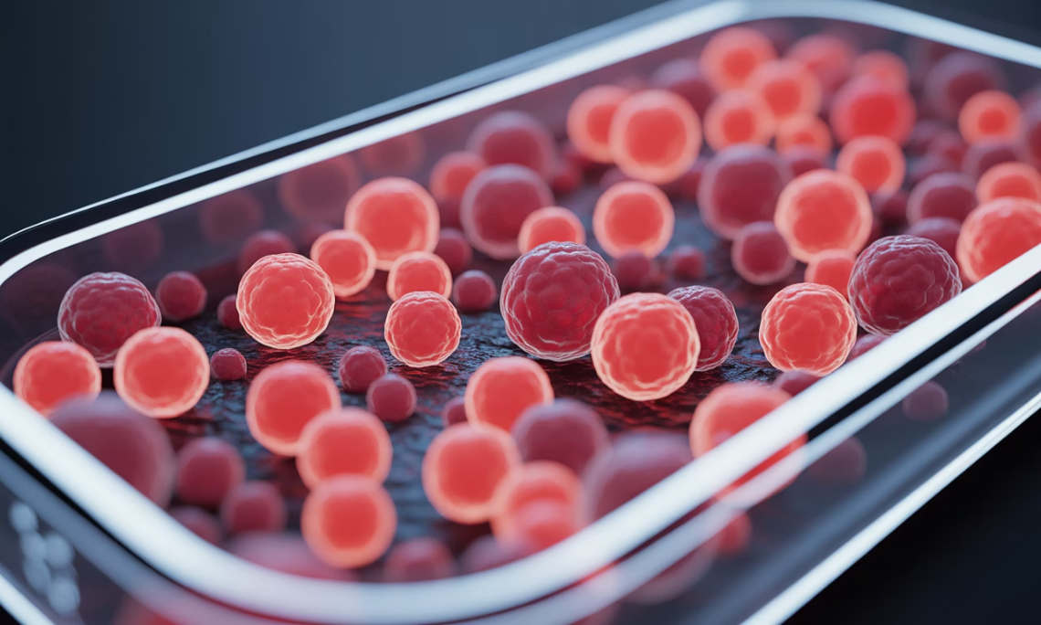
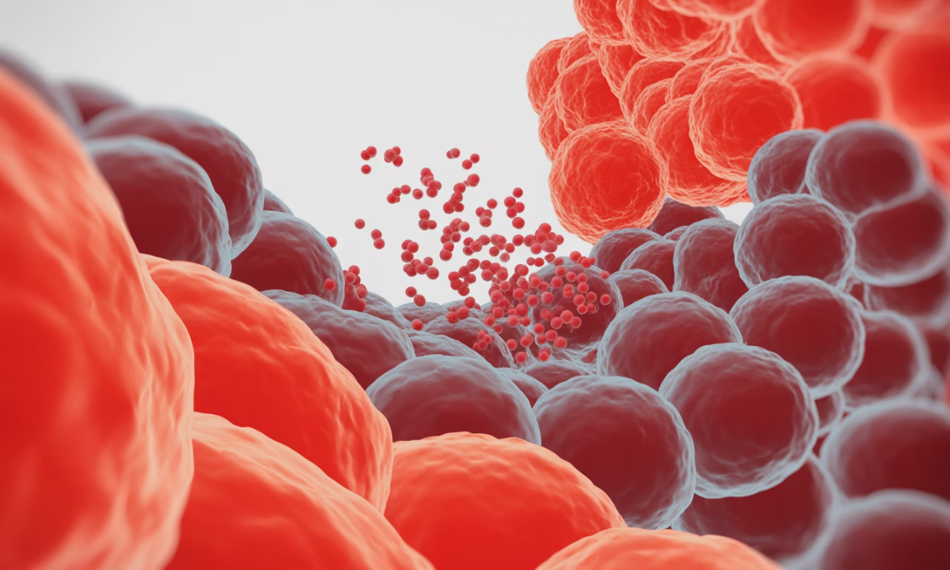
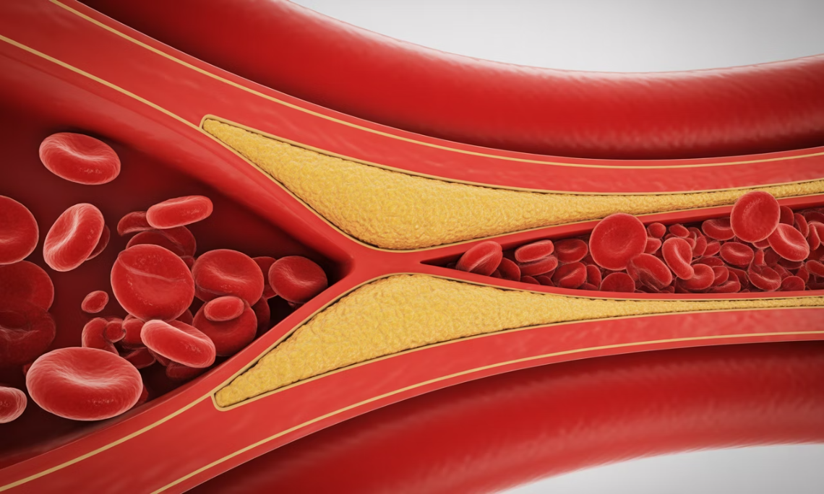






Case Studies & What's Next
Clinical Case Studies: Proof Points in Patients
Exagamglogene autotemcel (exa-cel/CASGEVY)
NTLA-2001
VERVE-101
Modality: Ex vivo CRISPR/Cas9 RNP editing of autologous HSPCs; BCL11A erythroid enhancer disruption induces fetal hemoglobin (HbF) to compensate for absent or defective adult hemoglobin.
Modality: In vivo CRISPR/Cas9 via lipid nanoparticle (LNP) encapsulating Cas9 mRNA and guide RNA targeting the TTR gene
Modality: In vivo adenine base editor (ABE) delivered via LNP; introduces an A-to-G edit in the PCSK9 gene to create a premature stop codon
Indications: Severe sickle cell disease with recurrent vaso-occlusive crises; transfusion-dependent β-thalassemia
Indication: Hereditary transthyretin amyloidosis (ATTR), a progressive systemic disease caused by hepatic production of misfolded TTR protein
Indication: Heterozygous familial hypercholesterolemia (HeFH), characterized by elevated LDL cholesterol and increased cardiovascular risk
Key Results: In pivotal trials, the majority of SCD patients experienced elimination of severe vaso-occlusive crises; TDT patients achieved transfusion independence with durable HbF induction (>90% of patients with >12 months follow-up).
Key Results: Single intravenous dose achieved dose-dependent serum TTR reductions—often >80–90% at higher doses—sustained out to 18+ months in early-phase cohorts. Clinical benefit signals (neuropathy scores, cardiac biomarkers) emerging in ongoing studies.
Key Results: Early clinical data show sustained LDL cholesterol reductions following single-dose administration; durability and safety profiles under continued observation in dose-escalation studies.
Notes: Requires myeloablative conditioning (busulfan) and complex manufacturing logistics (apheresis, cryopreservation, specialized transplant centers); long-term registry follow-up mandated for 15 years.
Notes: First demonstration of systemically delivered CRISPR editing in humans; validates in vivo liver editing feasibility and LNP platform; sets precedent for other hepatocyte-targeted programs.
Notes: First clinical base editing program; represents precision approach to "turn off" PCSK9 production without double-strand breaks; potential alternative to chronic PCSK9 inhibitor therapy.
What's Next: The Frontier of Genome Medicine
Prime Editing in the Clinic
Prime editors are advancing toward and entering clinical testing, promising precise corrections of disease mutations without double-strand breaks or donor templates—ideal for genetic diseases requiring small insertions or complex edits.
Extrahepatic Tropism
Next-generation LNPs with targeting ligands and engineered AAV capsids (via directed evolution, machine learning) will unlock lung, muscle, CNS, and other tissues—dramatically expanding the treatable disease space.
In Vivo Gene Insertion
Safe-harbor strategies (e.g., AAVS1, CCR5 locus) and integrase-based systems enable durable gene addition without random integration risk, supporting applications like enzyme replacement and hemophilia.
Multiplex Off-the-Shelf Therapies
Simultaneous knockout of endogenous TCR, HLA class I (B2M), and immune checkpoints creates universal allogeneic CAR-T/NK cells; logic-gating circuits add tumor-selectivity and minimize on-target/off-tumor toxicity.
Epigenome Editing
CRISPRi (interference) and CRISPRa (activation) fused to transcriptional repressors or activators enable reversible, titratable gene control without altering DNA sequence—attractive for complex polygenic traits.
Manufacturing & Access
Closed, automated systems (e.g., CliniMACS Prodigy, Lonza Cocoon) reduce labor and variability; distributed manufacturing hubs and outcomes-based pricing models expand global access and health equity.
The next decade will determine whether genome editing fulfills its promise as a broadly accessible pillar of medicine—or remains confined to rare diseases in wealthy markets. Success hinges on continued innovation in delivery, manufacturing, and equitable access frameworks.

